Slide 1
Test Driven Development with MS Test
Crystal Tenn
Crystal.Tenn@microsoft.com

Slide 2
What is Azure Batch Service?
Notes:
Benefits of containers include: Density and agility, enabling agile application development and deployment
Don’t mistake Hyper-V container with a VM – containers are much more agile (deploy with a flip of the bits, etc.)

Slide 3

What is Azure Batch Service?
A platform service for running large-scale parallel and high-performance computing (HPC) applications efficiently in the cloud.
Azure Batch schedules compute-intensive work to run on a managed collection of virtual machines, and can automatically scale compute resources to meet the needs of your jobs.

Slide 4
Demo 2
Persisting Data from Azure Batch Service to Azure Storage
Notes:
End 37 mins

Slide 5
AutoScale
Notes:
Benefits of containers include: Density and agility, enabling agile application development and deployment
Don’t mistake Hyper-V container with a VM – containers are much more agile (deploy with a flip of the bits, etc.)

Slide 6
Azure Batch Service Lab

Slide 7
C# 7 Features

Slide 8
Agenda
Simpler out variables
Tuples
Pattern Matching
ref locals and returns
Local Functions
More expression-bodied members
throw Expressions
Generalized async return types
Numeric literal syntax improvements

Slide 9
Out variables
Inline declaration
int numericResult;
if (int.TryParse(input, out numericResult))
WriteLine(numericResult);
else
WriteLine("Could not parse input");
if (int.TryParse(input, out int result))
WriteLine(result);
else
WriteLine("Could not parse input");
Notes:
The code is easier to read.
You declare the out variable where you use it, not on another line above.
No need to assign an initial value.
By declaring the out variable where it is used in a method call, you can't accidentally use it before it is assigned.
+
The most common use for this feature will be the Try pattern. In this pattern, a method returns a bool indicating success or failure and an out variable that provides the result if the method succeeds.

Slide 10
Tuple
Built in syntax
No more var x = Tuple<int,char>
No more x.Item1, x.Item2
Named
Used as
Parameter
Return value
Deconstruct a class
Notes:
Tuples were available before C# 7 as an API, but had many limitations. Most importantly, the members of these tuples were named Item1, Item2 and so on. The language support enables semantic names for the fields of a Tuple.
Tuples are most useful as return types for private and internal methods. Tuples provide a simple syntax for those methods to return multiple discrete values: You save the work of authoring a class or a struct that defines the type returned. There is no need for creating a new type.
Creating a tuple is more efficient and more productive. It is a simpler, lightweight syntax to define a data structure that carries more than one value. The example method below returns the minimum and maximum values found in a sequence of integers:

Slide 11
Pattern matching existed somewhat
public static int DiceSum2(IEnumerable<object> values)
{
var sum = 0;
foreach (var item in values)
{
if (item is int val)
sum += val;
else if (item is IEnumerable<object> subList)
sum += DiceSum2(subList);
}
return sum;
}
But what if you needed more than one type to check? => If/then/else craziness
Notes:
Pattern matching is a feature that allows you to implement method dispatch on properties other than the type of an object. You're probably already familiar with method dispatch based on the type of an object. In Object Oriented programming, virtual and override methods provide language syntax to implement method dispatching based on an object's type. Base and Derived classes provide different implementations. Pattern matching expressions extend this concept so that you can easily implement similar dispatch patterns for types and data elements that are not related through an inheritance hierarchy. +
Pattern matching supports is expressions and switch expressions. Each enables inspecting an object and its properties to determine if that object satisfies the sought pattern. You use the when keyword to specify additional rules to the pattern.+
is expressions
The is pattern expressions extend the familiar is operator to query a object beyond its type.

Slide 12
Extend to the switch statement
public static int DiceSum3(IEnumerable<object> values)
{
var sum = 0;
foreach (var item in values)
{
switch (item)
{
case int val:
sum += val;
break;
case IEnumerable<object> subList:
sum += DiceSum3(subList);
break;
}
}
return sum;
}
Notes:
The switch pattern expression has a familiar syntax, based on the switch statement already part of the C# language. Let's translate the existing code to use a switch expression before adding new cases
The switch expressions have a slightly different syntax than the is expressions, where you declare the type and variable at the beginning of the case expression.

Slide 13
Still supports constants, etc
public static int DiceSum4(IEnumerable<object> values)
{
var sum = 0;
foreach (var item in values)
{
switch (item)
{
case 0:
break;
case int val:
sum += val;
break;
case IEnumerable<object> subList when subList.Any():
sum += DiceSum4(subList);
break;
case IEnumerable<object> subList:
break;
case null:
break;
default:
throw new InvalidOperationException("unknown item type");
}
}
return sum;
}
Notes:
The code above adds cases for 0 as a special case of int, and null as a special case when there is no input. This demonstrates one important new feature in switch pattern expressions: the order of the case expressions now matters. The 0 case must appear before the general int case. Otherwise, the first pattern to match would be the int case, even when the value is 0.+
This same behavior enables the special case for an empty input sequence. You can see that the case for an IEnumerable item that has elements must appear before the general IEnumerable case.+
This version has also added a default case. The default case is always evaluated last, regardless of the order it appears in the source. For that reason, convention is to put the default case last.

Slide 14
Without ref locals and returns
public void TestFind(int[,] matrix)
{
var indices = Find(matrix, (val) => val == 42);
Console.WriteLine(indices);
matrix[indices.i, indices.j] = 24;
}
public (int i, int j) Find(int[,] matrix, Func<int, bool> predicate)
{
for (int i = 0; i < matrix.GetLength(0); i++)
for (int j = 0; j < matrix.GetLength(1); j++)
if (predicate(matrix[i, j]))
return (i, j);
return (-1, -1); // Not found
}
Notes:
This feature enables algorithms that use and return references to variables defined elsewhere. One example is working with large matrices, and finding a single location with certain characteristics. One method would return the two indices for a single location in the matrix:
There are many issues with this code. First of all, it's a public method that's returning a tuple. The language supports this, but user defined types (either classes or structs) are preferred for public APIs.+
Second, this method is returning the indices to the item in the matrix. That leads callers to write code that uses those indices to dereference the matrix and modify a single element:

Slide 15
With ref locals and returns
public void TestFind3(int[,] matrix)
{
ref var valItem = Find3(matrix, (val) => val == 42);
Console.WriteLine(valItem);
valItem = 24;
Console.WriteLine(matrix[4, 2]);
}
public ref int Find3(int[,] matrix, Func<int, bool> predicate)
{
for (int i = 0; i < matrix.GetLength(0); i++)
for (int j = 0; j < matrix.GetLength(1); j++)
if (predicate(matrix[i, j]))
return ref matrix[i, j];
throw new InvalidOperationException("Not found");
}
Notes:
When you declare that a method returns a ref variable, you must also add the ref keyword to each return statement. That indicates return by reference, and helps developers reading the code later remember that the method returns by reference:
Now that the method returns a reference to the integer value in the matrix, you need to modify where it's called. The var declaration means that valItem is now an int rather than a tuple:
The second WriteLine statement in the example above prints out the value 42, not 24. The variable valItem is an int, not a ref int. The var keyword enables the compiler to specify the type, but will not implicitly add the ref modifier. Instead, the value referred to by the ref return is copied to the variable on the left-hand side of the assignment. The variable is not a ref local.+
In order to get the result you want, you need to add the ref modifier to the local variable declaration to make the variable a reference when the return value is a reference:

Slide 16
Ref return rules
You cannot assign a value to a ref variable.
That disallows statements like ref int i = sequence.Count();
You cannot return a ref to a variable whose lifetime does not extend beyond the execution of the method.
That means you cannot return a reference to a local variable, or similar scope

Slide 17
Local functions
What?
The ability to declare methods and types in block scope.
Why?
This is already (kind of) possible by using the Func and Action types with anonymous methods. However, they lack a few features:
Generics
ref and out parameters
params

Slide 18
Local functions
public Task<string> PerformLongRunningWork(string address, int index, string name)
{
if (string.IsNullOrWhiteSpace(address))
throw new ArgumentException(message: "An address is required", paramName: nameof(address));
if (index < 0)
throw new ArgumentOutOfRangeException(paramName: nameof(index), message: "The index must be non-negative");
if (string.IsNullOrWhiteSpace(name))
throw new ArgumentException(message: "You must supply a name", paramName: nameof(name));
return longRunningWorkImplementation();
async Task<string> longRunningWorkImplementation()
{
var interimResult = await FirstWork(address);
var secondResult = await SecondStep(index, name);
return $"The results are {interimResult} and {secondResult}. Enjoy.";
}
}
Notes:
The version above makes it clear that the local method is referenced only in the context of the outer method. The rules for local functions also ensure that a developer can't accidentally call the local function from another location in the class and bypass the argument validation.

Slide 19
More expression bodied members
class ExpressionMembersExample
{
// Expression-bodied constructor
public ExpressionMembersExample(string label) => this.Label = label;
// Expression-bodied finalizer
~ExpressionMembersExample() => Console.Error.WriteLine("Finalized!");
private string label;
// Expression-bodied get / set accessors.
public string Label
{
get => label;
set => this.label = value ?? "Default label";
}
}

Slide 20
Throw expressions
private ConfigResource loadedConfig = LoadConfigResourceOrDefault() ??
throw new InvalidOperationException("Could not load config");
private string _name;
public string Name
{
get => _name;
set => _name = value ??
throw new ArgumentNullException(paramName: nameof(value), message: "New name must not be null");
}
Notes:
In C#, throw has always been a statement. Because throw is a statement, not an expression, there were C# constructs where you could not use it. These included conditional expressions, null coalescing expressions, and some lambda expressions. The addition of expression-bodied members adds more locations where throw expressions would be useful. So that you can write any of these constructs, C# 7 introduces throw expressions.+
The syntax is the same as you've always used for throw statements. The only difference is that now you can place them in new locations, such as in a conditional expression:
Previously, those initializations would need to be in a constructor, with the throw statements in the body of the constructor
Note
Both of the preceding constructs will cause exceptions to be thrown during the construction of an object. Those are often difficult to recover from. For that reason, designs that throw exceptions during construction are discouraged.

Slide 21
Generalized async return types
Can return types other than Task/void (they must still satisfy the async pattern)
e.g. ValueTask (from nuget System.Threading.Tasks.Extensions) can be a performance optimization in tight loops
public async ValueTask<int> Func()
{
await Task.Delay(100);
return 5;
}
Notes:
Returning a Task object from async methods can introduce performance bottlenecks in certain paths. Task is a reference type, so using it means allocating an object. In cases where a method declared with the async modifier returns a cached result, or completes synchronously, the extra allocations can become a significant time cost in performance critical sections of code. It can become very costly if those allocations occur in tight loops.+
The new language feature means that async methods may return other types in addition to Task, Task<T> and void. The returned type must still satisfy the async pattern, meaning a GetAwaiter method must be accessible. As one concrete example, the ValueTask type has been added to the .NET framework to make use of this new language feature:
Note
You need to add the pre-release NuGet package System.Threading.Tasks.Extensions in order to use ValueTask in Visual Studio 15 Preview 5

Slide 22
Numeric literal syntax improvements
public const int One = 0b0001;
public const int Two = 0b0010;
public const int Four = 0b0100;
public const int Eight = 0b1000;
public const int Sixteen = 0b0001_0000;
public const int ThirtyTwo = 0b0010_0000;
public const int SixtyFour = 0b0100_0000;
public const int OneHundredTwentyEight = 0b1000_0000;
public const long BillionsAndBillions = 100_000_000_000;
public const double AvogadroConstant = 6.022_140_857_747_474e23;
public const decimal GoldenRatio = 1.618_033_988_749_894_848_204_586_834_365_638_117_720_309_179M;
Binary literal
Digit separator

Slide 23
Things that didn’t make the cut (but may later)
Non nullable reference types
Records
Advanced pattern matching scenarios
https://github.com/dotnet/roslyn/issues + “Feature Request”

Slide 24
Questions?

Slide 25
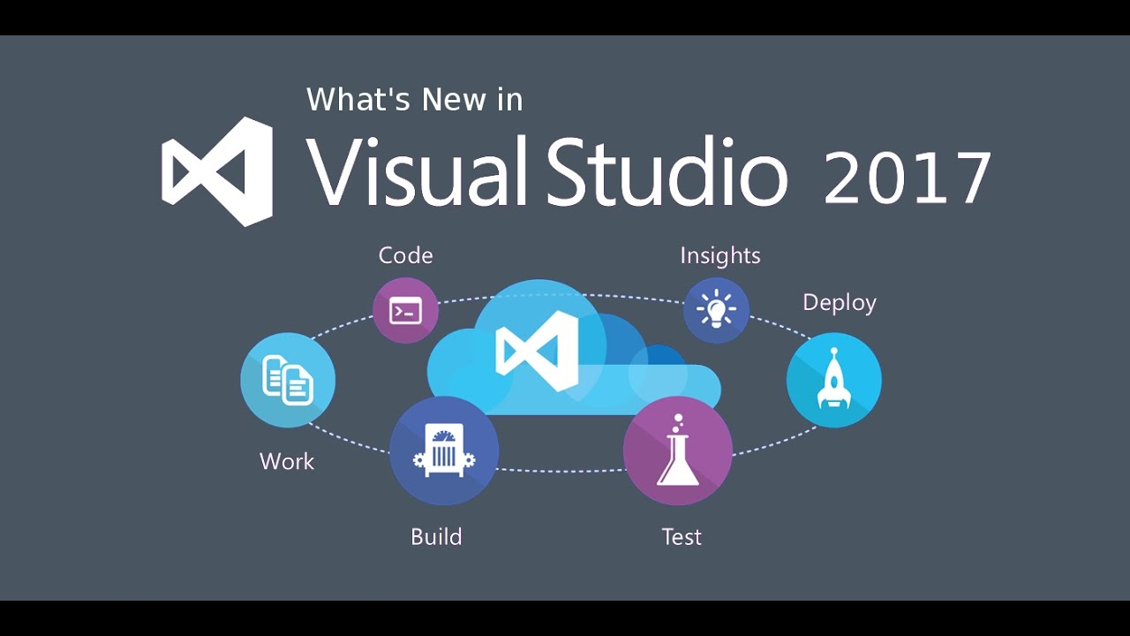
New Visual Studio 2017 Features

Slide 26
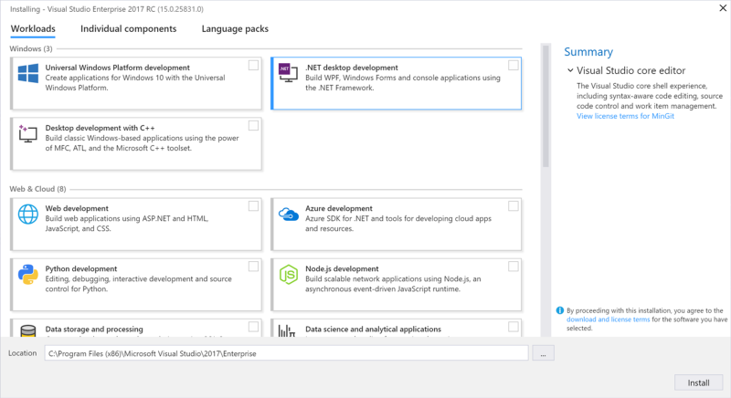
New setup experience
Notes:
Only a few minutes. The smallest install is just a few hundred megabytes, yet still contains basic code editing support for more than twenty languages along with source code control
Choose the workloads you need, and change them up when you need to..
We've also added different ways to install Visual Studio. Want to pick your own components instead of using workloads?
Simply select the Individual components tab from the installer.
Want to install Language Packs without also having to change the Windows language option? Choose the Language packs tab of the installer.
*show visual studio Installer on desktop

Slide 27
Visual Studio 2017
Faster Startup
Faster Solution load
Faster builds
Less memory
Notes:
Compared to VS 2015 Update 3..
Up to 3x faster for a cold start
2-4x faster at loading solutions
C++ gets faster builds
Uses less memory overall.
Next slide we will show a quick demonstration video comparing VS 2015 and 2017 loading times.

Slide 28

Notes:
(End around 4:12)

Slide 29
Visual Studio Performance Center
Can help you optimize your IDE start-up time.
The Performance Center lists all the extensions and tool windows that might slow down the IDE startup.
You can use it to improve startup performance by determining when extensions start, or whether tool windows are open at startup.

Slide 30
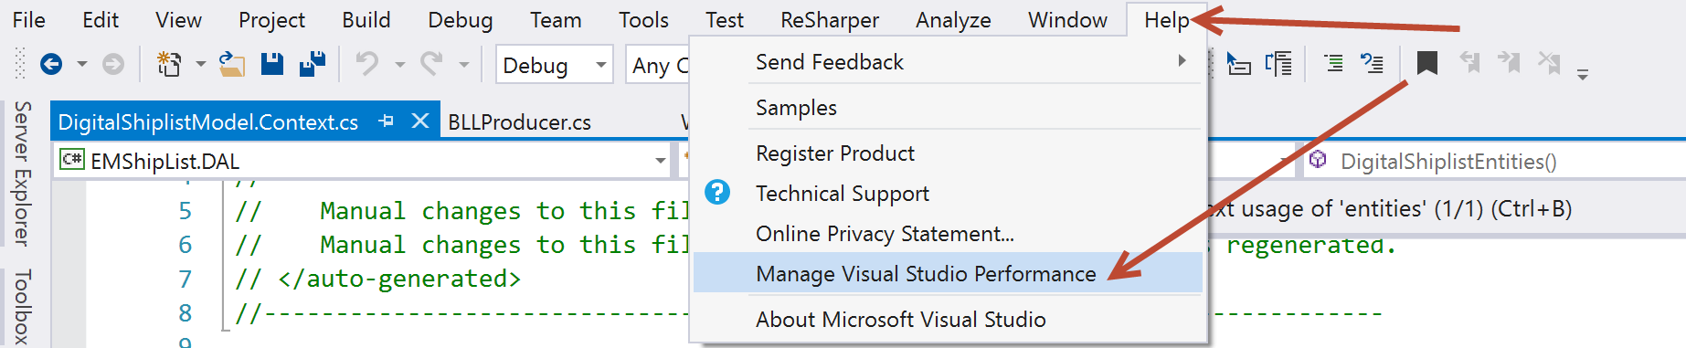
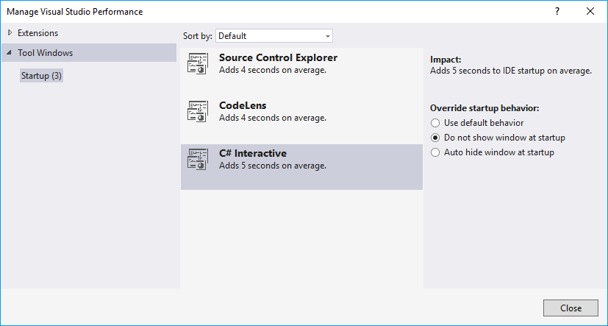
Perf improvements

Slide 31
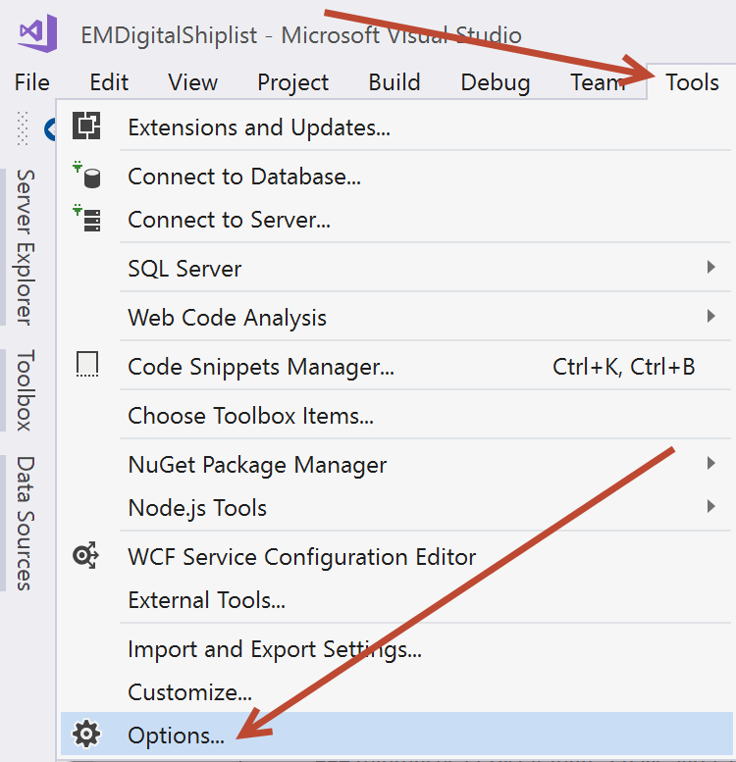
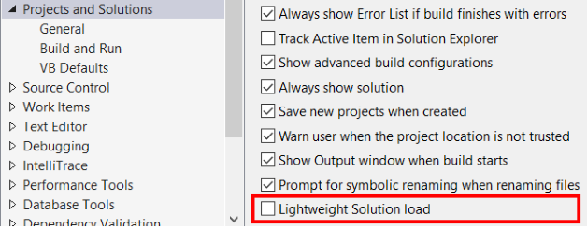
Perf improvements
Notes:
The ‘Lightweight Solution Load‘ feature minimizes this delay by skipping to load all the projects, when the solution is loaded. In simple words, the projects are not loaded until the time it is actually required. And this makes complete sense, since most of the real world scenarios like Navigating your code/ Editing your code/ Building your code, won’t require all projects to be loaded right at the beginning.
When you open/expand a project, you will notice a small delay and that’s when the project actually loads. So, the loading of the project is delayed until the user needs it.
At this point if you close the solution and open it again, you will find that the project which you had earlier opened, will be loaded by default. This is pretty nice, because Visual Studio recognizes/remembers users actions and loads the project at startup.

Slide 32
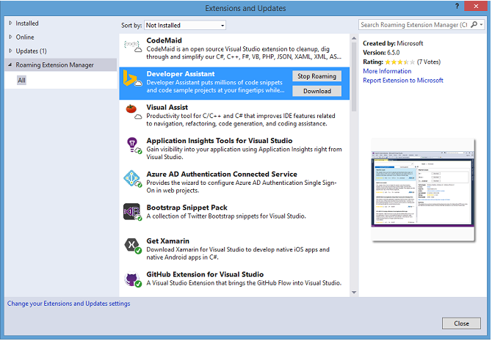
Productivity
Sign in across multiple accounts
Manage your extensions with Roaming Extensions Manager
Notes:
When you use the Roaming Extension Manager, you will notice 3 icon types on your list:+
Roamed Icon: An extension that is part of this Roaming List, but not installed on your machine. (You can install these by using the Download button.)
Roamed & Installed Icon: All extensions that are part of this Roaming List and installed in your dev environment. (If you decide you do not want to roam, you can remove these by using the Stop Roaming button.)
Installed Icon: All extensions that are installed in this environment, but are not part of your Roaming List. (You can add extensions to the Roaming List by using the Start Roaming button.)
+
These icons show you the current status of your list. You can have any extension in any state, so customize to your heart's content! Or let us do it for you! Any extension that you download while you are signed in is added to your list as Roamed & Installed and is part of your Roaming list, which gives you access to it from any machine!

Slide 33
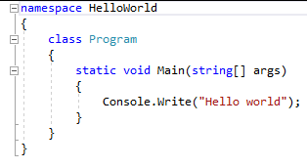
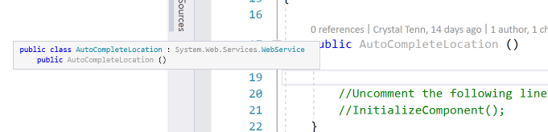
Structure Visualizer
Vertical guidelines
Hover to see source of container
Nested code visualization
C#, VB and XAML (and others)

Slide 34
Visual Studio 2017 Features
Navigation
IntelliSense
Run to Click
Notes:
Run to click so you no longer need to set temporary breakpoints.
More quick actions and refactoring like ‘move type to matching file’
Navigate to is much more powerful, better filtering and preview
IntelliSense filtering. It is not smarter about which element is selects by default

Slide 35
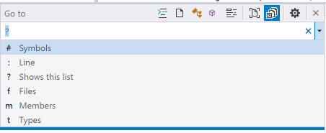
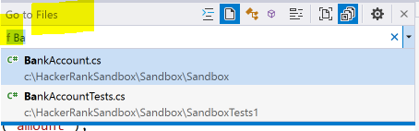
Go To (combined with old “Navigate to”)
Ctrl+, or Ctrl+T
Filters
# = Symbol
F = file name
M = members
T = type
: = line number (Ctrl-g)
Notes:
Search “patt” as file, member and type
Show go to is not included in this dialog

Slide 36
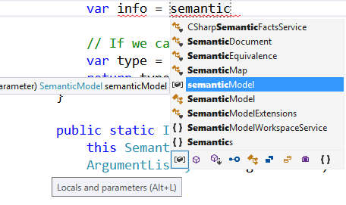
Intellisense filters
Notes:
IntelliSense Improvements
This release also introduces improvements to IntelliSense that will make you more productive when working in a large solution or an unfamiliar codebase. We have added an icon tray to IntelliSense that enables you to filter the member list by type (e.g., methods, properties, classes, etc.). Each filter toggle has an associated keyboard shortcut which you can discover by hovering over the icon. To enable this feature, go to Tools > Options > Text Editor > [C# / Basic] > IntelliSense and check the options for filtering and highlighting.

Slide 37
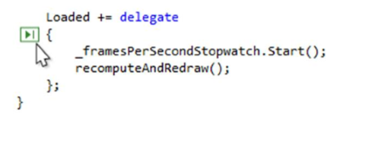
Run to click
Easily skip ahead during debugging without setting a breakpoint to stop on the line you want.
When you are stopped in the debugger, simply click the icon that appears next to the line of code that your mouse is over.
Your code will run and stop on that line the next time it is hit in your code path.
Notes:
Now, you can more easily skip ahead during debugging without setting a breakpoint to stop on the line you want. When you are stopped in the debugger, simply click the icon that appears next to the line of code that your mouse is over. Your code will run and stop on that line the next time it is hit in your code path.

Slide 38
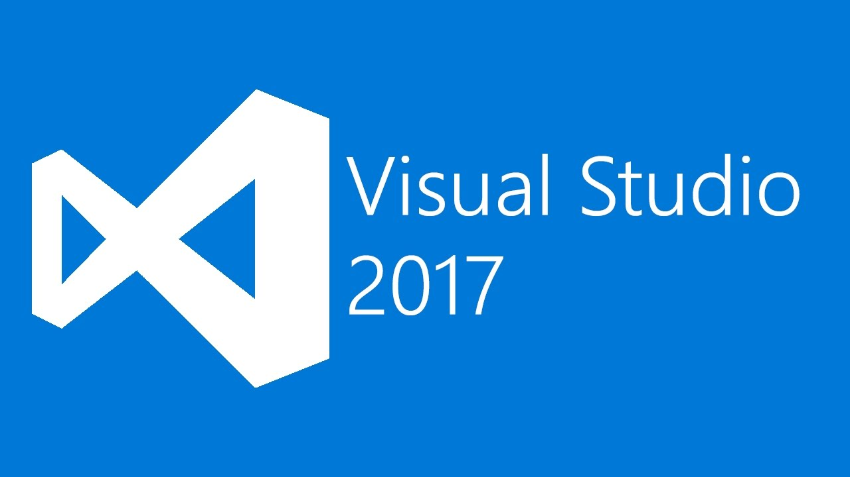
Demo on navigation, IntelliSense, and Run to Click
Notes:
(10 mins before demo)

Slide 39
Visual Studio 2017 Demo Summary
Navigation
All the navigation is together under the Edit menu now
Improved Navigate To which is now called Go To All
CTRL + T or CTRL + ,
VS opens files in temporary viewer as you scroll through search results
IntelliSense
Filters have been added
Smarter about finding Capital letters ‘SV’ would find ‘Set Value’ method for example
Most likely rather than simply a top property
Find All References has grouping, colors, and a peek preview
Run to Click
Click green glyph on any lines of code below a breakpoint to go there
Perf tip glyph tells how long execution took and can open performance diagnostics tools window
Notes:
(12 mins after demo, before slide)
Run to click so you no longer need to set temporary breakpoints.
More quick actions and refactoring like ‘move type to matching file’
Navigate to is much more powerful, better filtering and preview
IntelliSense filtering. It is not smarter about which element is selects by default

Slide 40
Visual Studio 2017 Features
Live Code Analysis
Real-Time architecture validation
Live Unit Testing
Notes:
Runs analysis rules and flags issues in the editor. Helps you to quickly identify errors, best practices, and style rules. You can also apply refactoring, code actions, or code fixes. MSTest, xUnit, or NUnit testing framework all work with Live Code Analysis.
Real-Time architecture validation provides real time notifications of architectural rules violations.
Unit testing: coverage and pass fail information are brought discreetly into the editor.

Slide 41
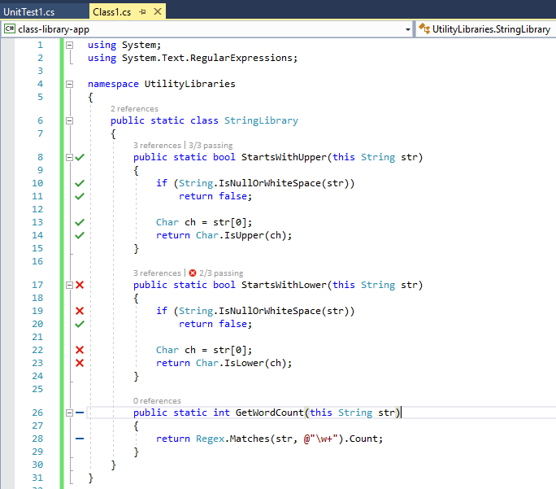
Live unit testing
Only in Enterprise edition
Visualizes test results on the editor during coding
C#/VB.NET w/ MSTest, xUnit, NUnit

Slide 42
Demo on Live Unit Testing
Notes:
(14 mins before demo)

Slide 43
Visual Studio 2017 Demo Summary
Live Unit Testing
Tests > Live Unit Testing > Start

Slide 44
VS2017 Streamlined Cloud Development
Docker
DevOps
.NET Core and Linux
Notes:
Docker is a software container platform. everything required to make a piece of software run is packaged into isolated containers. Unlike VMs, containers do not bundle a full operating system - only libraries and settings required to make the software work are needed. This makes for efficient, lightweight, self-contained systems and guarantees that software will always run the same, regardless of where it’s deployed. Developers use Docker to eliminate “works on my machine” problems when collaborating on code with co-workers. Integrated tooling to package your application into Docker containers and to deploy to the cloud.
For dev ops: Better Git based version control. Simpler experiences for continuous integration and continuous deployment pipelines.
.NET Core support is better. You can now take a .NET core, target it to linux, package it to a docker container, publish to a docker registry, then run it in the cloud. .NET core is a top 10 platform for performance and much faster than ASP.NET.

Slide 45
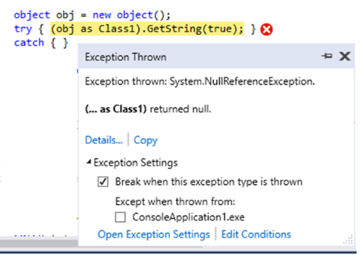
New exception helper
Breaking on the Line of Code – No matter if you are managed or native debugging, when you break on an exception the debugger will stop you on the line of code where that exception happens.
Exception Information at a Glance – You will instantly be able to read the exception type and exception message in the Exception Helper, and whether the exception was thrown or unhandled.
Notes:
Null Reference Analysis – Starting in VS 2017 , for both managed and native code, when you hit a NullReferenceException or an Access Violation, you will see null analysis information in the Exception Helper. If we cannot determine what is null we will not attempt to show any analysis. When we can detect what is null we will emphasize the culprit in bold text.
Configure your Exception Settings – When you break on Exception Thrown you can use the checkbox under Exception Settings in the Exception Helper to disable breaking on that exception type when thrown in the future. You can also specify that you do not want to break on this particular exception thrown in this particular module by checking the box by the module name under “Except when thrown from:” in the Exception Settings. You can apply conditions to your exceptions to only break when thrown from certain modules.

Slide 46
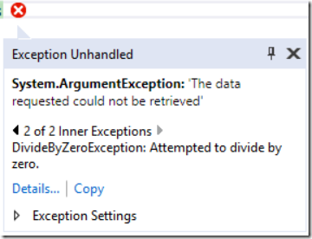
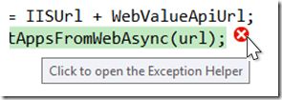
New exception helper
Inner Exceptions right away – No longer will you have to drill into the exception details to see if there is an inner exception. We show it to you right when you break with the ability to navigate back through multiple inner exceptions.
Notes:
Move it where you need it – You can drag the Exception Helper from its pinned view to its floating view. You can also use the pin icon to float it, or snap it back to the line of code. If you close the Exception Helper, simply click on the exception error indicator to bring it back up.
Faster breaking for Unhandled Exceptions – When managed debugging, the debugger will no longer automatically unwind the Call Stack when you break on an unhandled exception. This means that you will break into your code faster because the debugger doesn’t need to walk the Call Stack before breaking.
Non-Modal – When native debugging, you will no longer need to dismiss an exception dialog to inspect your code. The new Exception Helper is available right inline next to your code.

Slide 47
Redgate Data Tools
To extend DevOps capabilities to SQL Server database development, Redgate Data Tools are now available in the following editions of Visual Studio 2017.
Included with Visual Studio 2017 Enterprise:
Redgate ReadyRoll Core
Redgate SQL Prompt Core
Included with all editions of Visual Studio 2017:
Redgate SQL Search
Notes:
Redgate ReadyRoll Core helps you develop migration scripts, manage database changes using source control, and safely automate deployments of SQL Server database changes alongside applications changes.
Redgate SQL Prompt Core helps you write SQL more quickly and accurately with the help of intelligent code completion. SQL Prompt autocompletes database and system objects and keywords, and offers column suggestions as you type. This results in cleaner code and fewer errors because you don't have to remember every column name or alias.
Included with all editions of Visual Studio 2017:
Redgate SQL Search increases your productivity by helping you quickly find SQL fragments and objects across multiple databases.

Slide 48
C# 7 Features
Notes:
(start here around 20 mins)

Slide 49
Agenda
Simpler out variables
Tuples
Pattern Matching
ref locals and returns
Local Functions
More expression-bodied members
throw Expressions
Generalized async return types
Numeric literal syntax improvements

Slide 50
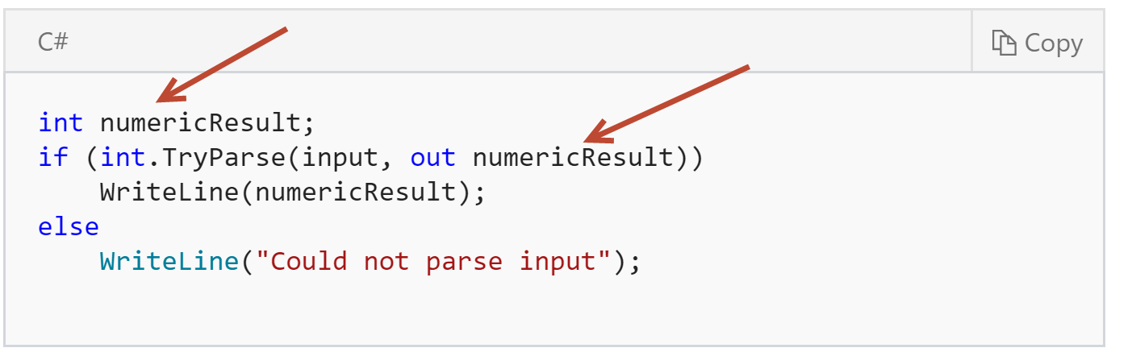
Old out parameters
Notes:
Previously, you would need to separate the declaration of the out variable and its initialization into two different statements:

Slide 51
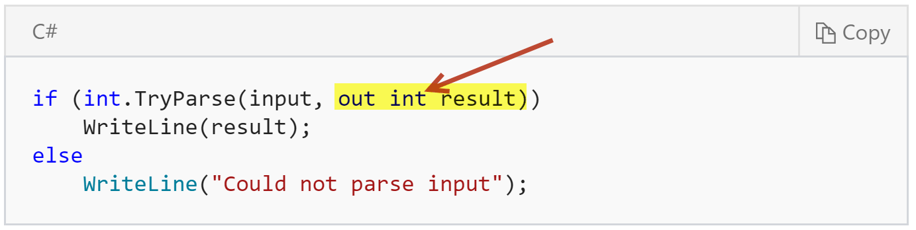
C# 7.0 out parameters
Notes:
You can now declare out variables in the argument list of a method call, rather than writing a separate declaration statement:
You may want to specify the type of the out variable for clarity, as shown above. However, the language does support using an implicitly typed local variable as seen on the next slide

Slide 52
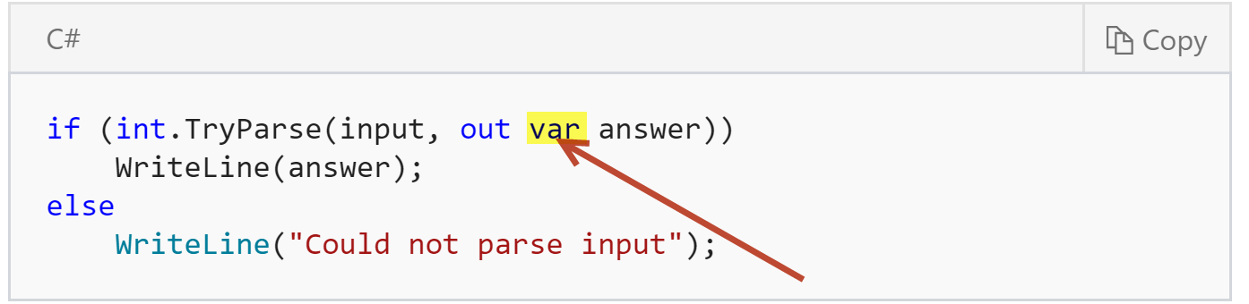
C# 7.0 out parameters
Notes:
The code is easier to read.
You declare the out variable where you use it, not on another line above.
No need to assign an initial value.
By declaring the out variable where it is used in a method call, you can't accidentally use it before it is assigned.
The most common use for this feature will be the Try pattern. In this pattern, a method returns a bool indicating success or failure and an out variable that provides the result if the method succeeds.
On the next slide one more feature of the new out parameter..

Slide 53
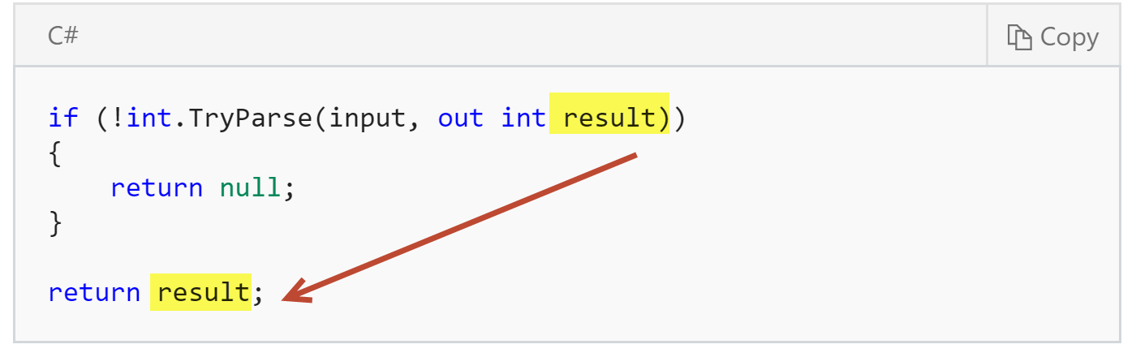
C# 7.0 out parameters scope ‘leak’
Notes:
When using the out variable declaration, the declared variable "leaks" into the outer scope of the if statement. This allows you to use the variable afterwards:

Slide 54
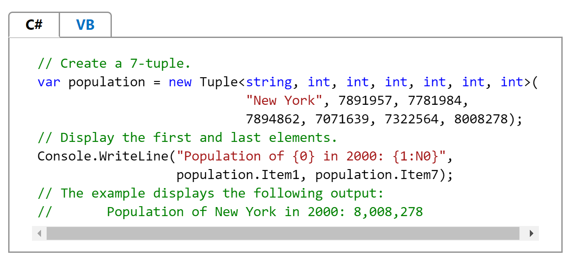
Old tuples

Slide 55
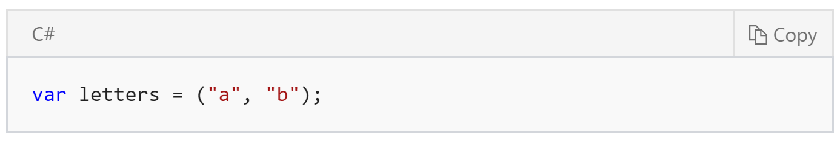
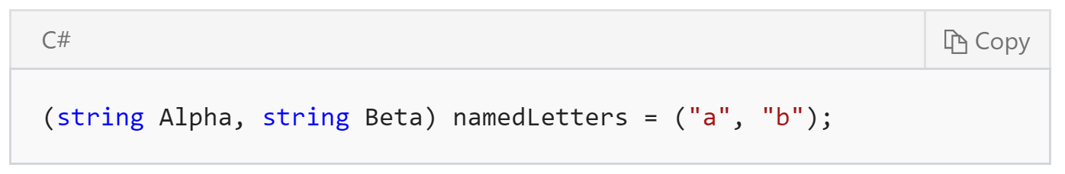
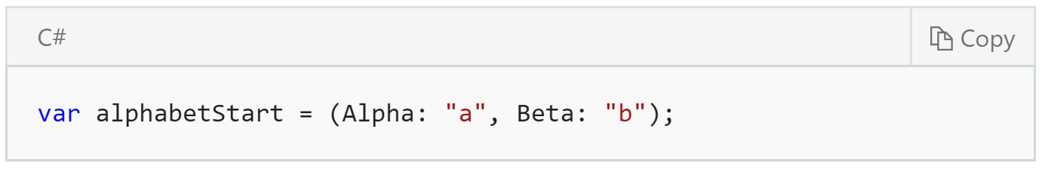
C# 7.0 tuples
Notes:
That assignment creates a tuple whose members are Item1 and Item2, which you can use in the same way as Tuple You can change the syntax to create a tuple that provides semantic names to each of the members of the tuple:
The namedLetters tuple contains fields referred to as Alpha and Beta. Those names exist only at compile time and are not preserved for example when inspecting the tuple using reflection at runtime.
You can specify Names on both the left or the right side of assignment

Slide 56
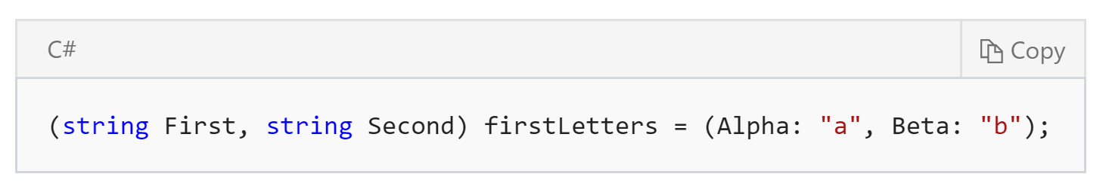
C# 7.0 tuples
Notes:
You can specify names for the fields on both the left AND right-hand side of the assignment:
The line above generates a warning, CS8123, telling you that the names on the right side of the assignment, Alpha and Beta are ignored because they conflict with the names on the left side, First and Second.
The examples above show the basic syntax to declare tuples. Tuples are most useful as return types for private and internal methods. Tuples provide a simple syntax for those methods to return multiple discrete values: You save the work of authoring a class or a struct that defines the type returned. There is no need for creating a new type.

Slide 57
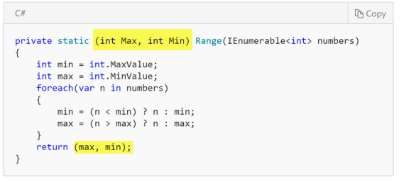
C# 7.0 Tuples Min and Max
Notes:
(25-26 mins before slide)
Using tuples in this way offers several advantages:+
You save the work of authoring a class or a struct that defines the type returned.
You do not need to create new type.
The language enhancements removes the need to call the Create<T1>(T1) methods.

Slide 58
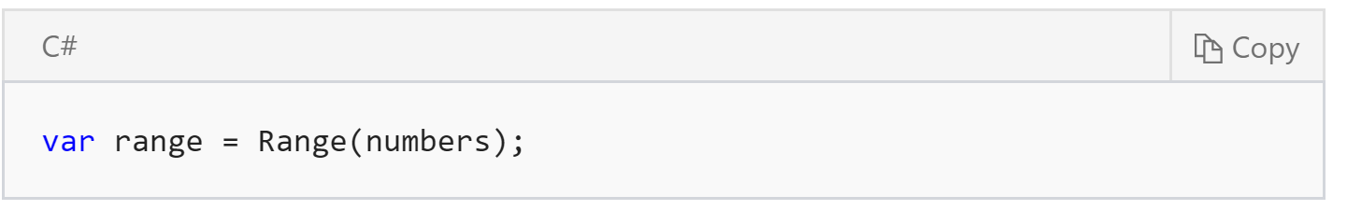
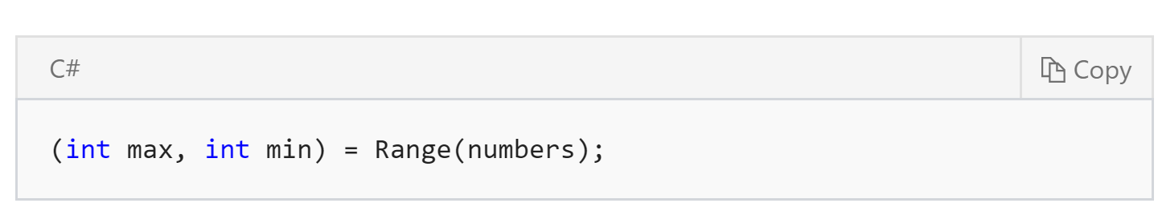
C# 7.0 Tuples Min and Max

Slide 59
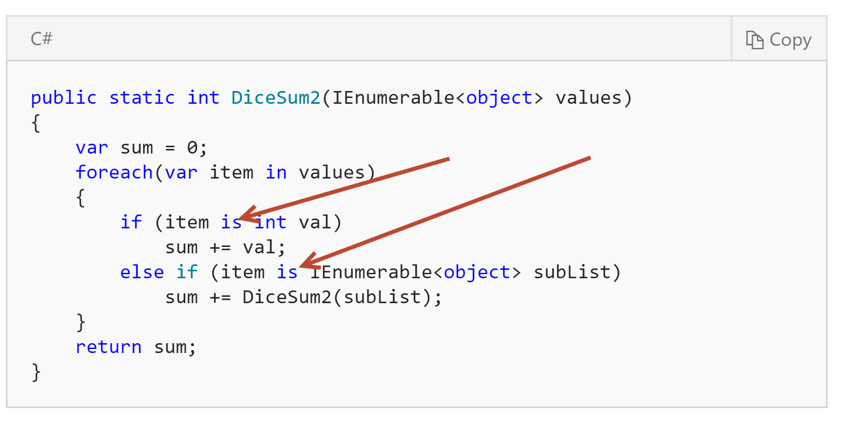
C# 7.0 Pattern Matching with ‘is’
Notes:
You might quickly find that you need to find the sum of die rolls where some of the rolls are made with more than one die. Part of the input sequence may be multiple results instead of a single number:

Slide 60
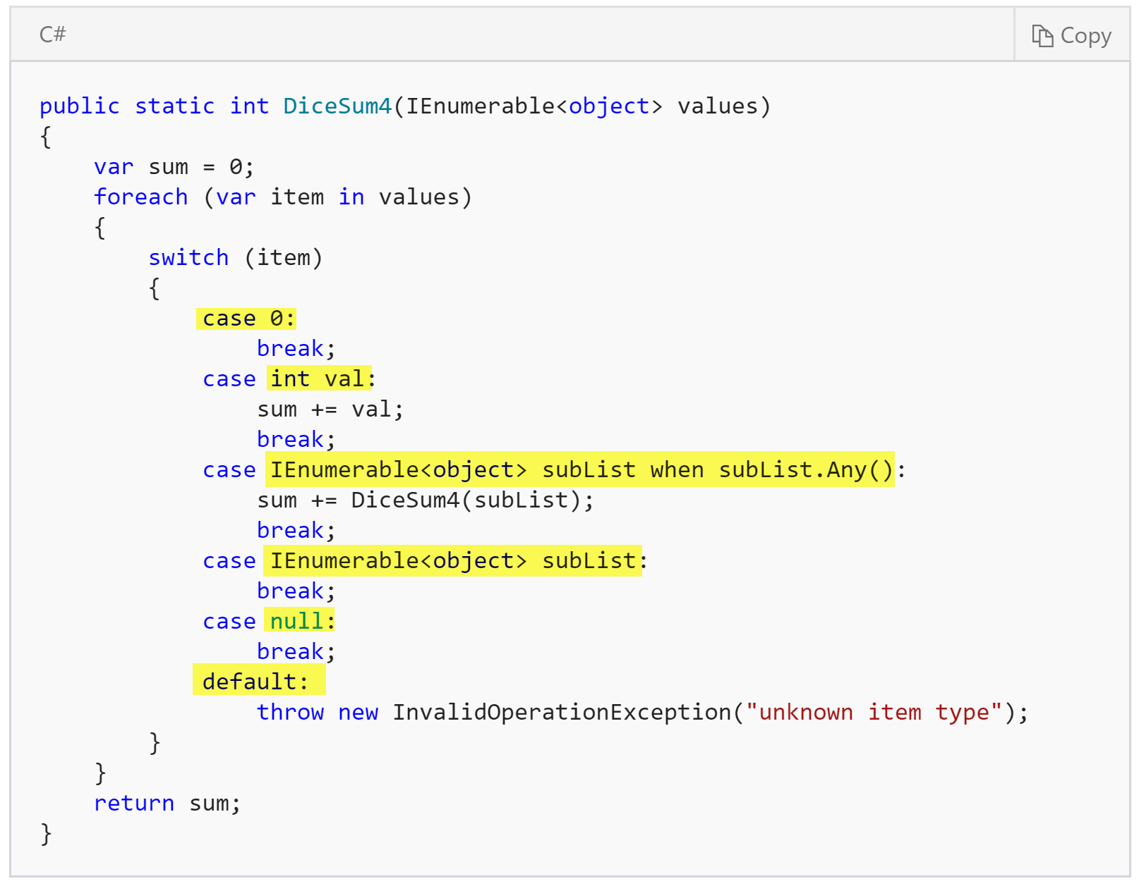
C# 7.0 Pattern Matching with ‘switch’
Notes:
The code above adds cases for 0 as a special case of int, and null as a special case when there is no input. This demonstrates one important new feature in switch pattern expressions: the order of the case expressions now matters. The 0 case must appear before the general int case. Otherwise, the first pattern to match would be the int case, even when the value is 0. If you accidentally order match expressions such that a later case has already been handled, the compiler will flag that and generate an error.
This same behavior enables the special case for an empty input sequence. You can see that the case for an IEnumerable item that has elements must appear before the general IEnumerable case.
This version has also added a default case. The default case is always evaluated last, regardless of the order it appears in the source. For that reason, convention is to put the default case last.
(end around 30 mins)

Slide 61
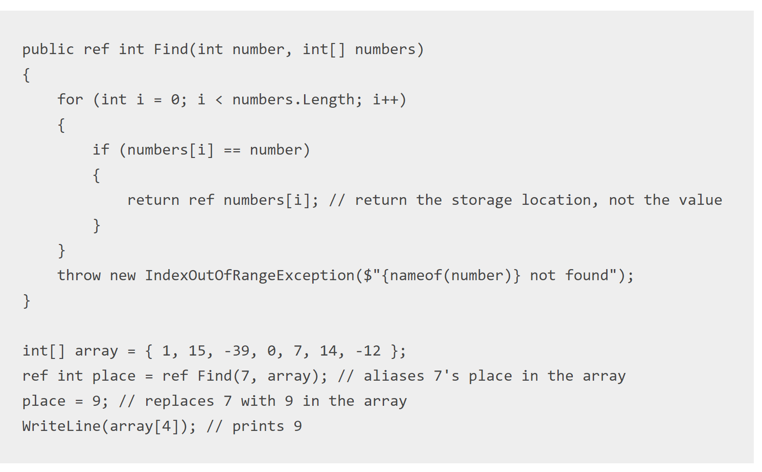
C# 7.0 ref locals and returns
Notes:
This is useful for passing around placeholders into big data structures. For instance, a game might hold its data in a big preallocated array of structs and you can pass refs to the values in the array so you can edit them.. Therefore you wont have to keep creating and making copies of struct which have to be garbage collected which cause pauses. Methods can now return a reference directly to such a struct, through which the caller can read and modify it.
There are some restrictions to ensure that this is safe:
You can only return refs that are “safe to return”: Ones that were passed to you, and ones that point into fields in objects.
Ref locals are initialized to a certain storage location, and cannot be mutated to point to another.
The ref keyword with C# just offers an easier syntax compared to the pointers from the C programming language.
This enables scenarios where you want pass references to internal structures without resorting to unsafe code (pointers to pinned memory). Those mechanisms are both unsafe and inefficient.
Why is it useful?
Returning values by reference can improve performance in cases where the alternative is either pinned memory, or copying resources. This features enables developers to continue to use verifiably safe code, while avoiding unnecessary copies.
It may not be a feature you use on a daily basis, but for algorithms that require large amounts of memory for different structures, this feature can have a significant positive impact on the performance of your application.
(End 32 min)

Slide 62
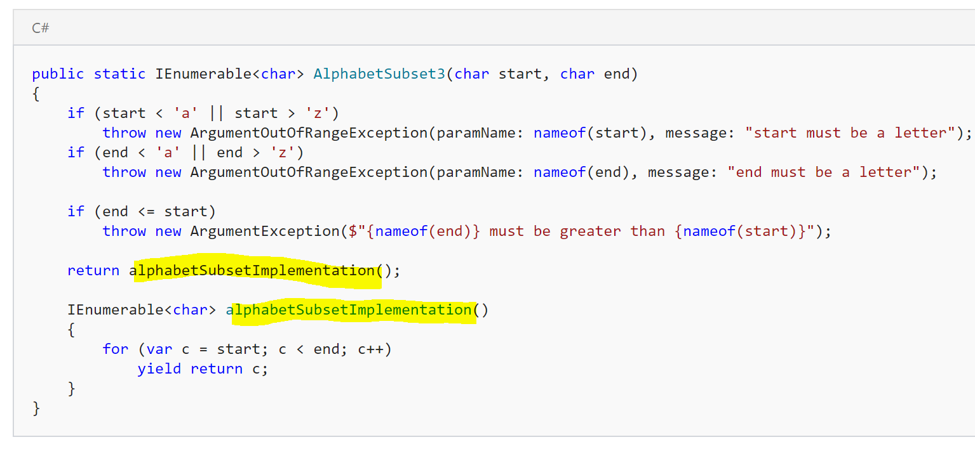
C# 7.0 Local Functions - Iterative
Notes:
local functions enable you to declare methods inside the context of another method. This makes it easier for readers of the class to see that the local method is only called from the context in which is it declared.
There are two very common use cases for local functions: public iterator methods and public async methods. Both types of methods generate code that reports errors later than programmers might expect. In the case of iterator methods, any exceptions are observed only when calling code that enumerates the returned sequence. In the case of async methods, any exceptions are only observed when the returned Task is awaited.
The code in the slide makes it clear that the local method is referenced only in the context of the outer method. The rules for local functions also ensure that a developer can't accidentally call the local function from another location in the class and bypass the argument validation.
(end at 34mins)

Slide 63
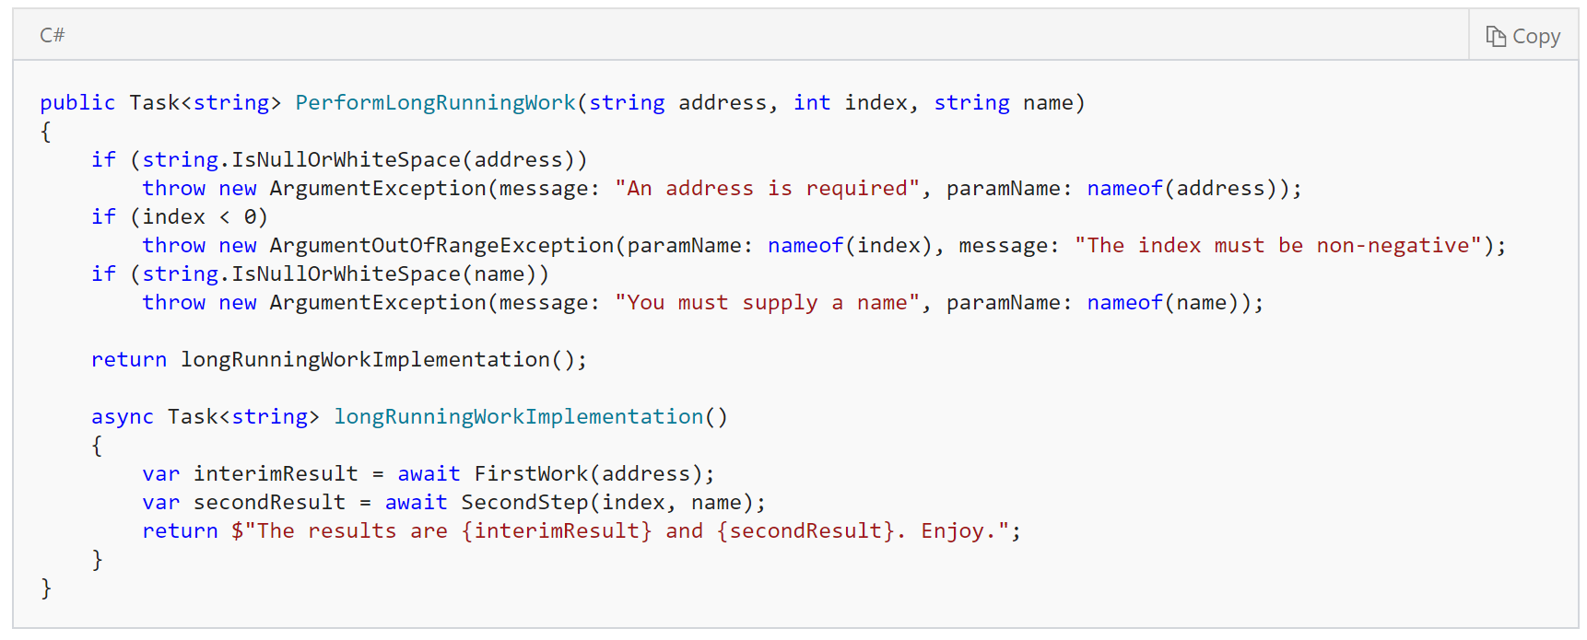
C# 7.0 Local Functions - Async
Notes:
The same technique can be employed with async methods to ensure that exceptions arising from argument validation are thrown before the asynchronous work begins. We don’t want to do the null/exception checks in the async part and let it go, best to find that out ahead of time synchronously.

Slide 64
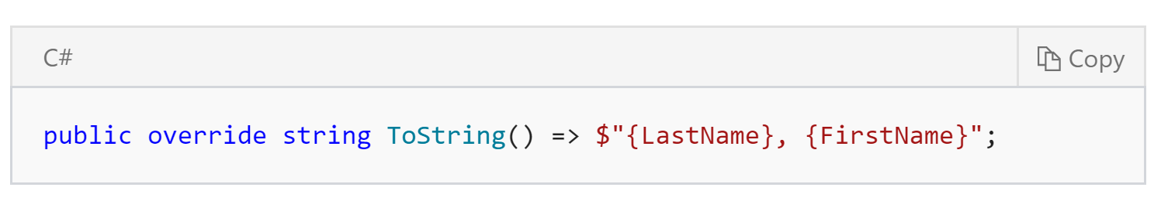
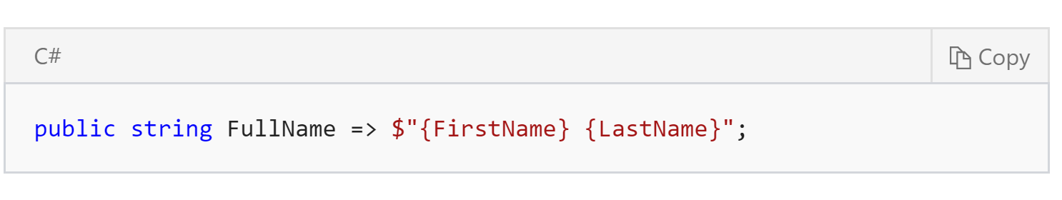
Old expression-bodied function members
Notes:
In C# 6.0, we introduced expression bodied function members
You can reduce that syntax by writing an expression-bodied member instead. It works for methods and read-only properties." For example, an override of ToString() is often a great candidate
You can also use expression-bodied members in read only properties as well:+

Slide 65
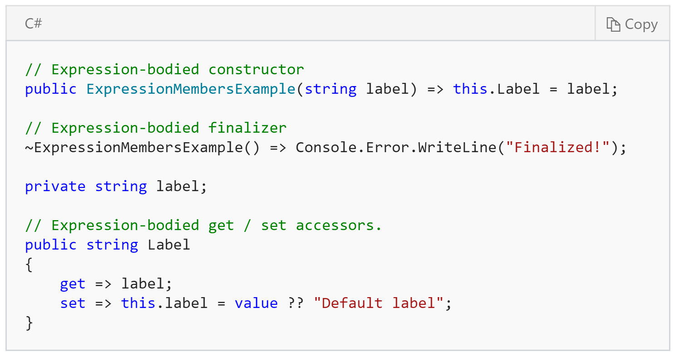
C# 7.0 More expression-bodied members
Notes:
C# 6 introduced expression-bodied members for member functions, and read-only properties. C# 7 expands the allowed members that can be implemented as expressions. In C# 7, you can implement constructors, finalizers, and get and set accessors on properties and indexers.
When your object is no longer needed you call the C# garbage collector, which calls your destructor.
This example does not need a finalizer, but it is shown to demonstrate the syntax. You should not implement a finalizer in your class unless it is necessary to release unmanaged resources.

Slide 66
C# 7.0 Shorthand for expression-bodied members
// C#6 Destructor
~Person()
{
Console.WriteLine("Destructor was called!");
}
~Person() => Console.Error.WriteLine("C# 7 Destructor was called!");
Notes:
These are equivalent!

Slide 67
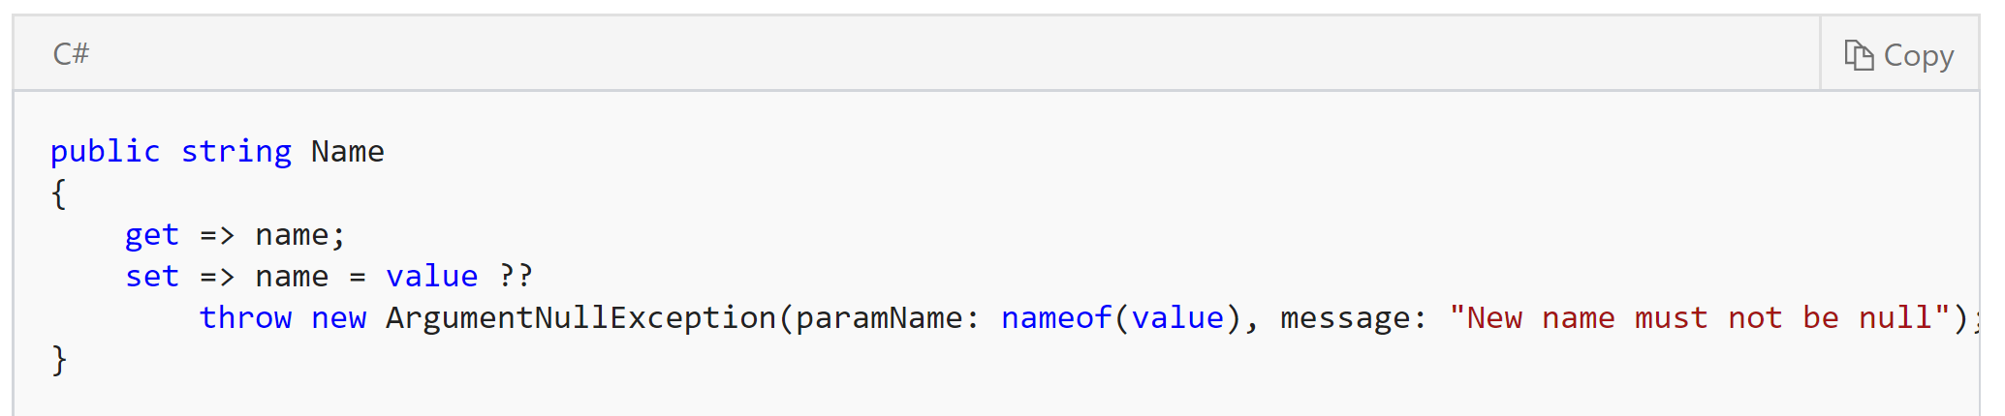
C# 7.0 Throw expressions
Notes:
In C#, throw has always been a statement. Because throw is a statement, not an expression, there were C# constructs where you could not use it. These included conditional expressions, null coalescing expressions, and some lambda expressions. The addition of expression-bodied members adds more locations where throw expressions would be useful. The syntax is the same as you've always used for throw statements.
To summarize.. only difference is that now you can place them in new locations, such as in a conditional expression:
(end 38 mins)

Slide 68
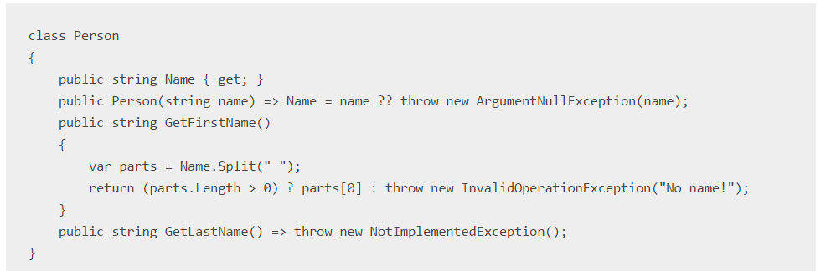
C# 7.0 Throw Expressions
Notes:
null coalescing expression
conditional expressions
lambda expressions.

Slide 69
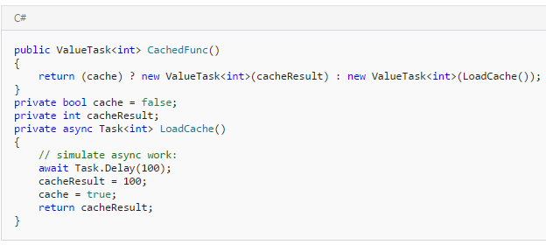
C# 7.0 Generalized async return types
Notes:
The new language feature means that async methods may return other types in addition to Task, Task<T> and void.
There are tradeoffs to using a ValueTask<TResult> instead of a Task<TResult>. For example, while a ValueTask<TResult> can help avoid an allocation in the case where the successful result is available synchronously, it also contains two fields whereas a Task<TResult> as a reference type is a single field
ValueTask is designed for the very scenario when the return value might be known immediately – cached from a previous invocation for example.
the default choice for any asynchronous method should be to return a Task or Task<TResult>. Only if performance analysis proves it worthwhile should a ValueTask<TResult> be used instead of Task<TResult>.

Slide 70
C# 7.0 Numeric literal syntax improvements
public const int One = 0b0001;
public const int Two = 0b0010;
public const int Four = 0b0100;
public const int Eight = 0b1000;
public const int Sixteen = 0b0001_0000;
public const int ThirtyTwo = 0b0010_0000;
public const int SixtyFour = 0b0100_0000;
public const int OneHundredTwentyEight = 0b1000_0000;
public const long BillionsAndBillions = 100_000_000_000;
public const double AvogadroConstant = 6.022_140_857_747_474e23;
public const decimal GoldenRatio = 1.618_033_988_749_894_848_204_586_834_365_638_117_720_309_179M;
Binary literal
Digit separator
Notes:
C# 7 includes two new features to make it easier to write numbers in the most readable fashion for the intended use: binary literals, and digit separators.
The 0b at the beginning of the constant indicates that the number is written as a binary number.
Binary numbers can get very long, so it's often easier to see the bit patterns by introducing the _ as a digit separator:
The digit separator can be used with decimal, float and double types as well:
(end 40 minsd)

Slide 71
Things that didn’t make the cut (but may later)
Non nullable reference types
Proposal here: https://gist.github.com/olmobrutall/31d2abafe0b21b017d56
Pattern matching and Record types
https://github.com/dotnet/roslyn/blob/features/records/docs/features/records.md
Advanced pattern matching scenarios
https://github.com/dotnet/roslyn/blob/features/patterns/docs/features/patterns.md
https://github.com/dotnet/roslyn/issues + “Feature Request”
Notes:
More modern languages (like Swift or Haskell) by default don't allow nulls to get in, but types can be expanded to allow nulls when necessary using the Maybe monad (in Haskell), or Optional types.
Unfortunately, this perfect solution will create massive backward compatibility problems in C#, and keeping backwards compatibility is what makes C# 'enterprise friendly', so this is an attempt to get the best possible solution with this restrictions.
Pattern matching extensions for C# enable many of the benefits of algebraic data types and pattern matching from functional languages
Records are a new, simplified declaration form for C# class and struct types
(end 42 mins)

Slide 72
Useful Links
Microsoft docs: https://docs.microsoft.com/en-us/
C# Get started guide: https://www.microsoft.com/net/tutorials/csharp/getting-started/hello-world
New in C#: https://docs.microsoft.com/en-us/dotnet/articles/csharp/whats-new/csharp-7
New in VS: https://docs.microsoft.com/en-us/visualstudio/ide/whats-new-in-visual-studio

Slide 73
Thank you!

